Slide 1
Harnessing social media to enhance impact
Effective communications planning and promotion for your programme
James Thornton, communications manager, HQIP

Slide 2
The planning horse, the social media cart
Create a simple communications plan – help is at hand
‘Boil down’ your project objectives
Who needs to know what for awareness and improvement?
What are the most effective ways to talk to them?
Q: Is social media part of that mix?
A: Very, very likely...

Slide 3
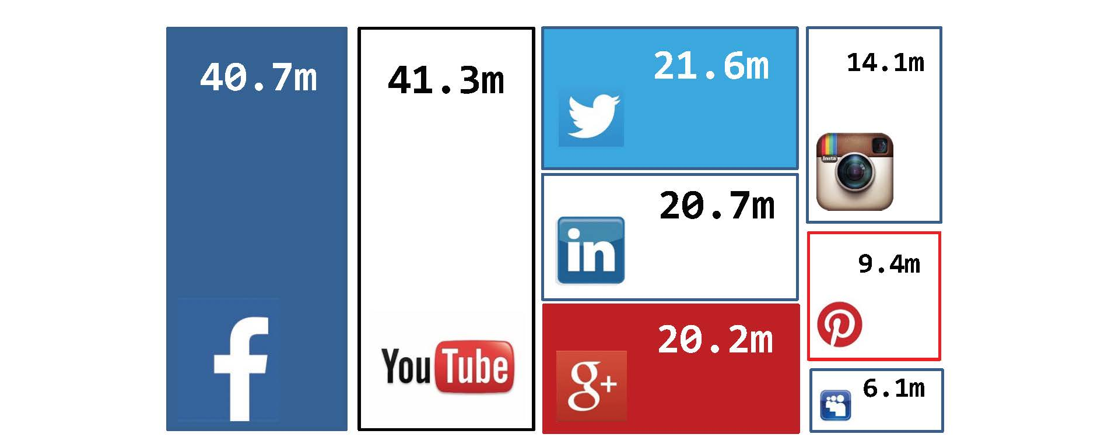

The sheer power of social media
‘Social media’ refers to websites and applications that enable users to create and share content or to participate in social networking
38.7m
41.3m
20.9m
16.5m
21.8m
11.5m
12.8m
16.7m
Source: Ofcom, 2016

Slide 4
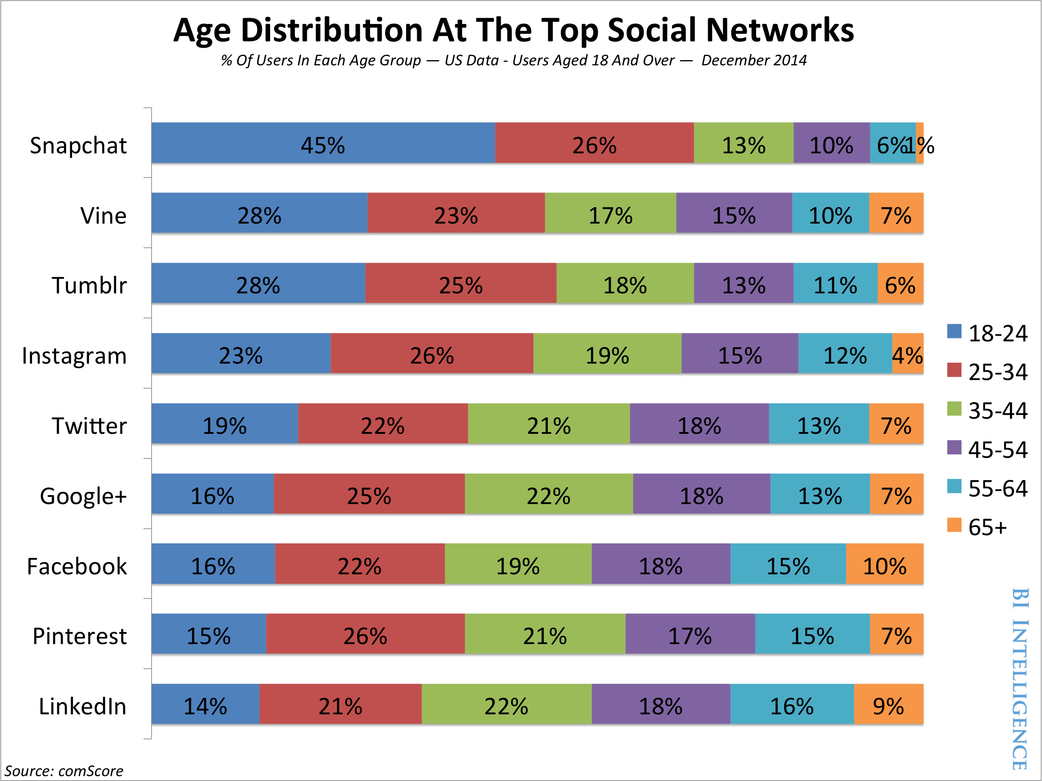



Age distribution at top social networks

Slide 5
But clinicians don’t use tech for work do they?
Devices surpassed desktops for web usage last November (GlobalStatsCounter, Nov. 2016)
BMJ Innovations study (Oct. 2015):
  99% doctors, 95% nurses own smartphones
  74% and 65% own tablets
  93% and 53% found phones ‘useful in performing clinical duties’
  90% and 67% medical app owners using them for work

Slide 6
Case study 1: RCP and DIY
Most audits have Twitter accounts: RCP_FFFAP @SSNAPaudit @RCP_NLCA @NatCOPDaudit
Managers? Project teams with support and guidance from comms
Drivers? Project teams and CQID exec leadership: account managers cascade plans and results
Benefits: Audits talk directly to their audiences
Support: Messages shared across broader RCP social media platforms to complement strategic messaging
Successes: Followers: SSNAP – 784, COPD – 699 NLCA – 320, FFFAP – 462

Slide 7
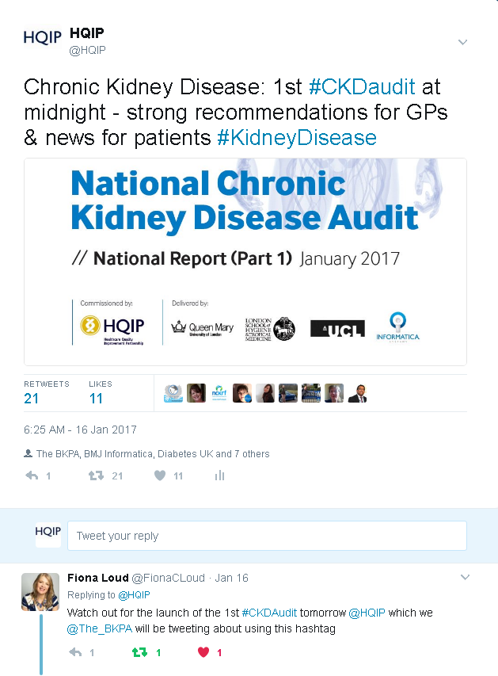
Case study 2: CKD launch – low cost, high impact
January 2017 – HQIP promotion of the National CKD audit
Week-long social media campaign comprising visuals, statistics and infographics
Campaign kicked off with a teaser tweet prior to report publication

Slide 8
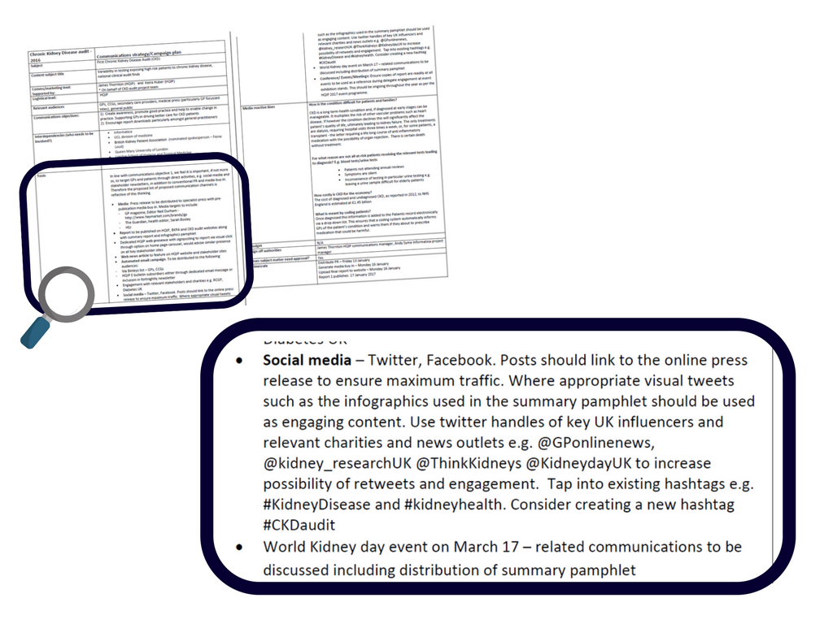
Case study 2: CKD – right planning, right mix

Slide 9
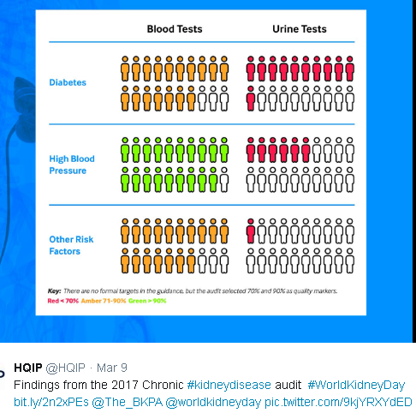
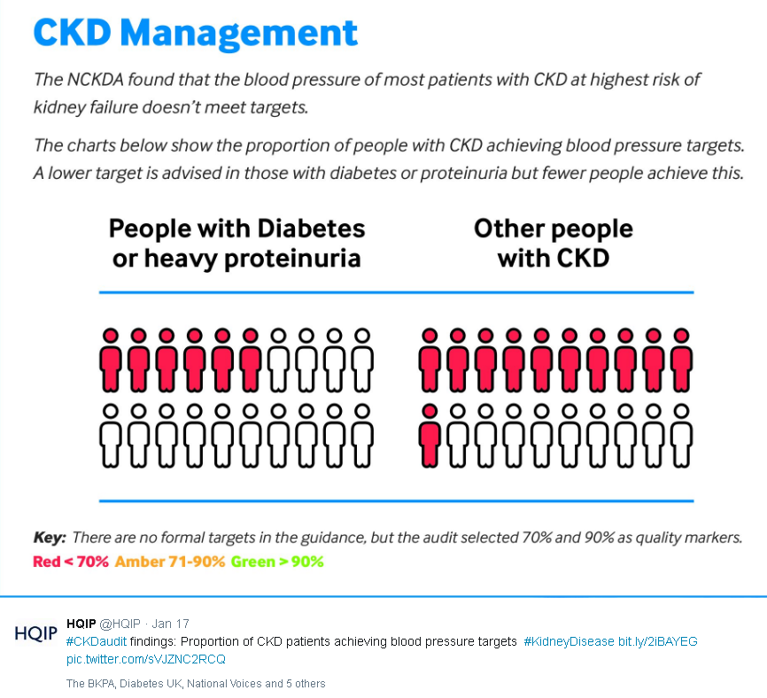
Case study 2: CKD – good design, big impact
Infographics are ‘liked’ and shared on social media 3x more than other any other type of content

Slide 10
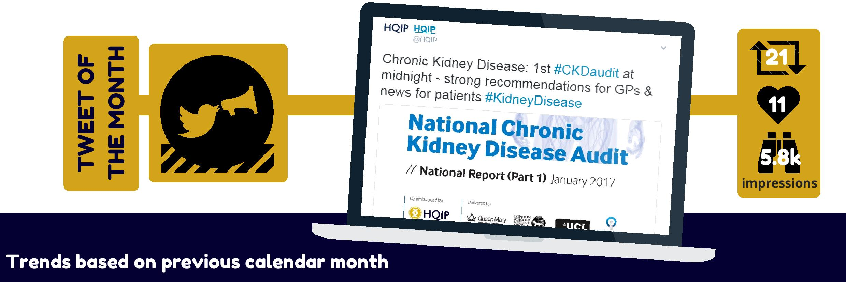
Case study 2: CKD – social media success
HQIP ‘Tweet of the Month’
Pulse (32k followers) GP Magazine (15.5k)
Re-Tweets & likes: RCP (30k), National Voices (9k)
World Kidney Day – a second bite at the cherry

Slide 11
Case study 3: The NJR and strategy

Slide 12
Case study 3: The NJR and strategy

Slide 13
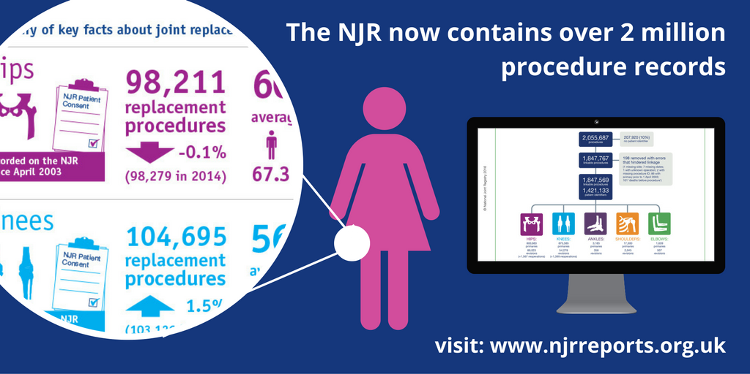
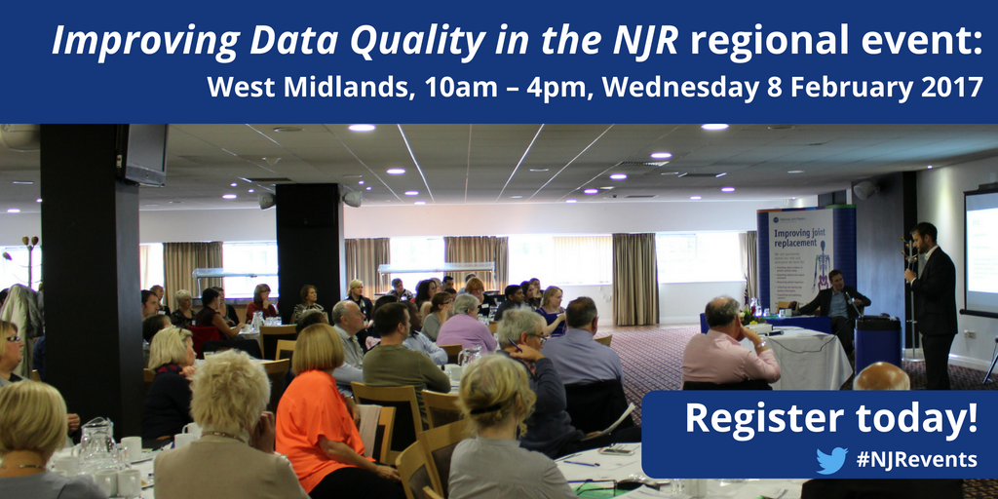
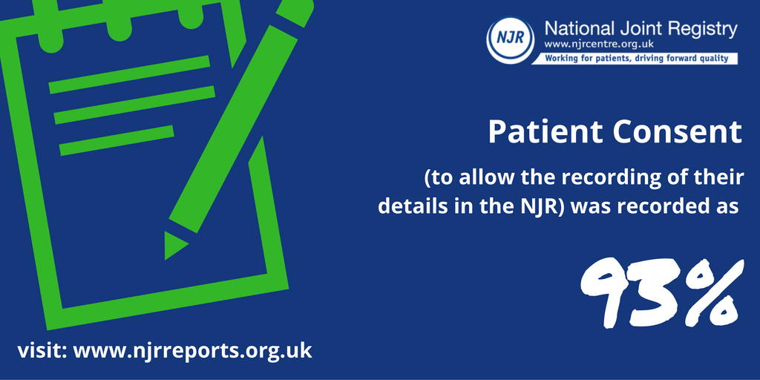
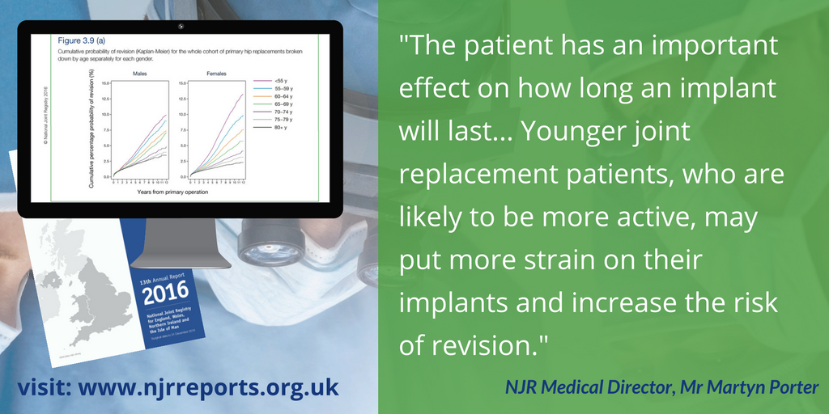
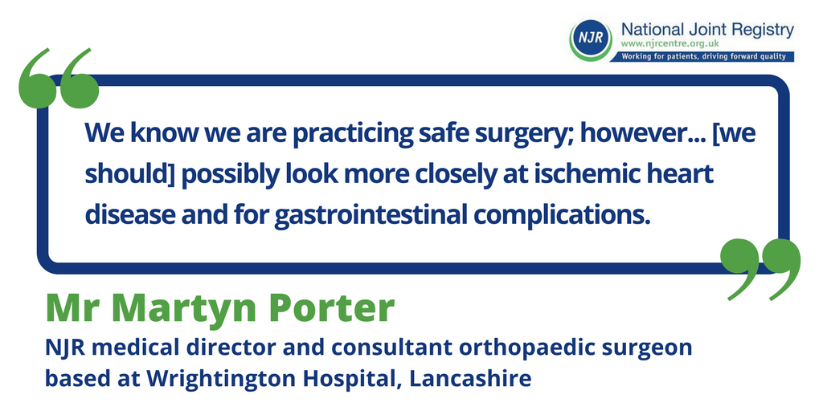
Case study 3: NJR – simple, effective design
Introducing more visual content – this can be done via https://www.canva.com/

Slide 14
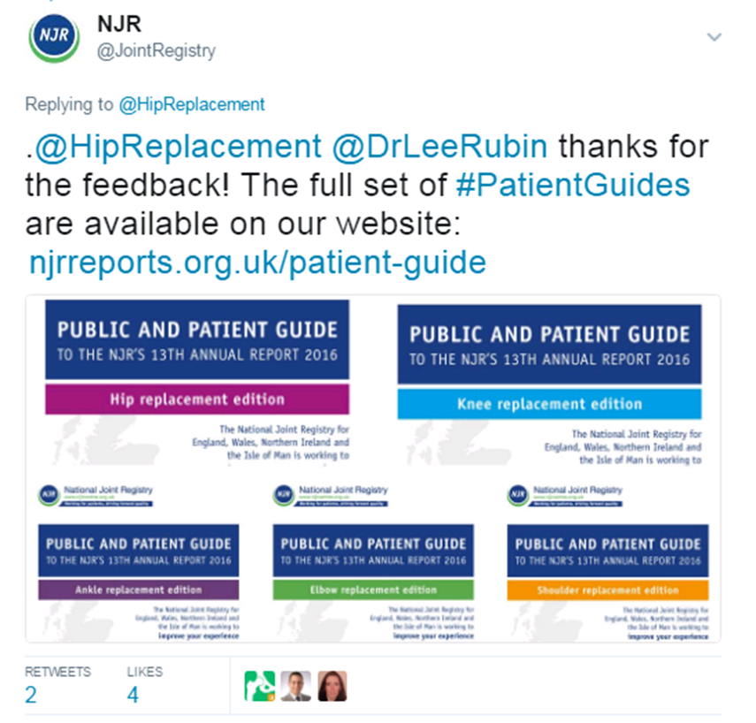
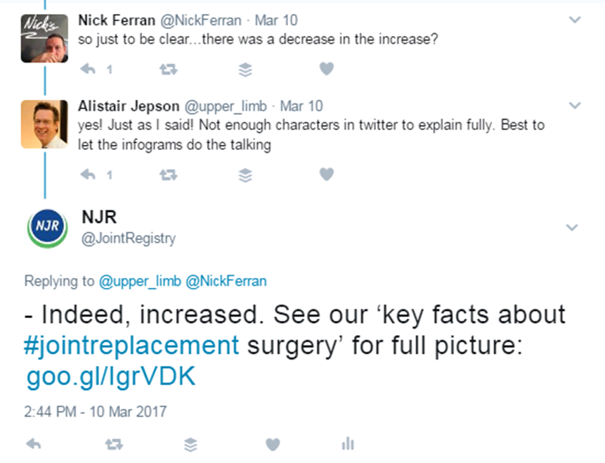
Case study 3: NJR – simple, effective engagement
Developing a conversation and signposting

Slide 15
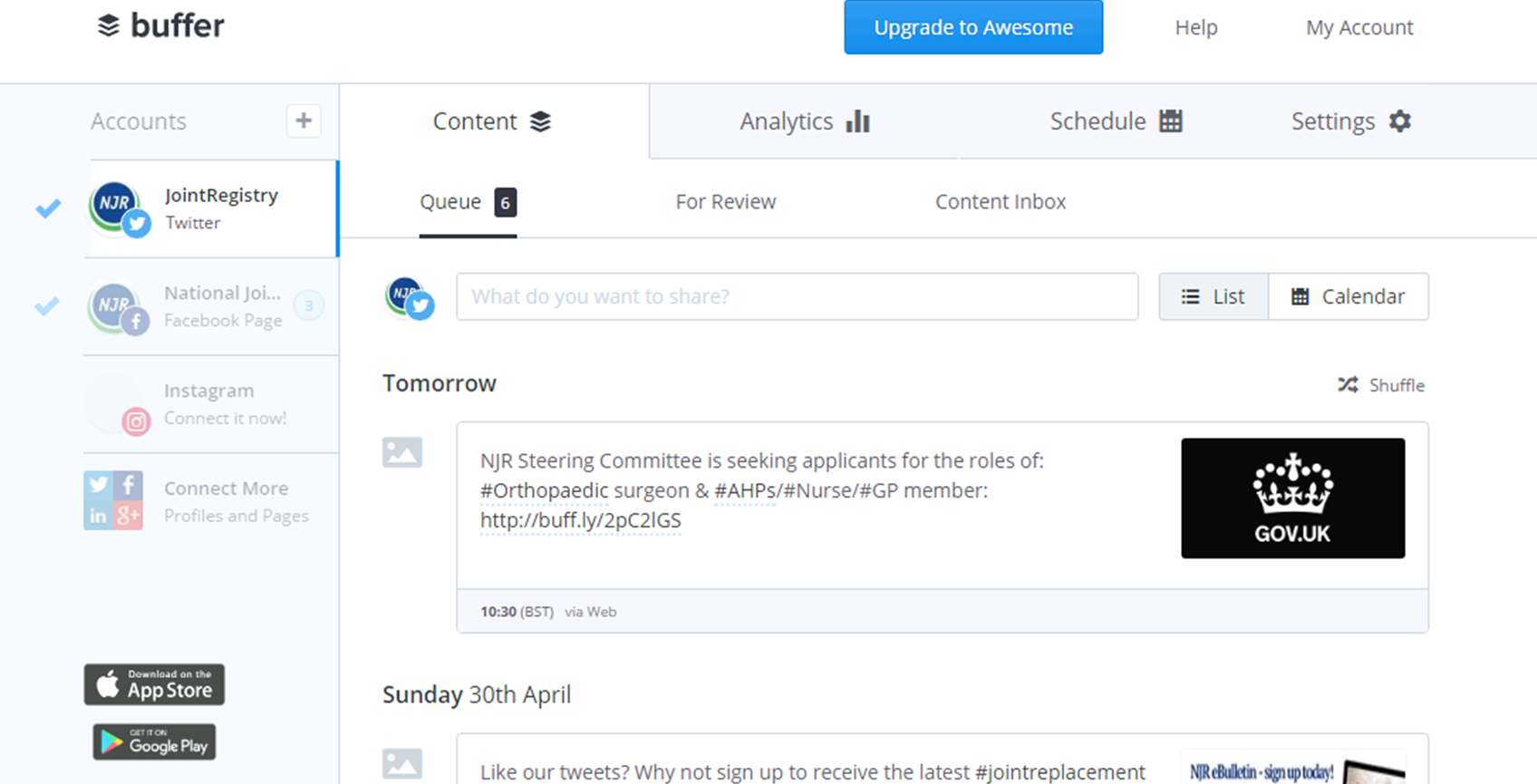
Case study 3: NJR – simple scheduling
Regular updates/ posts – often by using scheduling tool(s): https://buffer.com

Slide 16
Thank you
Any questions?
james.thornton@hqip.org.uk

